Slide 1
IM-PROVE – application for volunteers
When, where
Notes:
Project Youth Employability via Volunteering was implemented from December 2016 till the end of October 2018. INEX-SDA as coordinator of the project cooperated with organisations Zavod Voluntariat from Slovenia and Solidarités Jeunesses from France. Main topic was connecting volunteering and learning (for the volunteers to perceive more their progress thanks to volunteering activities), cooperation of volunteering and labour market and generally recognition of non-formal learning of volunteers outside the non-profit sector. Among main outputs of the project, the application IM-PROVE (improve.inexsda.cz) was upgraded, and we created two more outputs: research about how labour market (especially private sector) preceives volunteering and handbook for youth / volunteering project leaders how to reflect learning in these projects with groups of participants (handbook.inexsda.cz). The project was supported by the Erasmus + programme.

Slide 2
IM-PROVE – application for volunteers
Tool to record volunteering experiences and their „translation“ into the language of competences (knowledge, skills, attitudes).
It helps the volunteers:
understand and word, what they learned through volunteering
have recorded all the volunteering experiences in different roles on one spot
record their experiences and competences into CV for example
plan their next development
It contributes to recognition of volunteering experiences at other sectors.
Notes:
Reflection of learning in volunteering is often complicated – usually, one needs a good mentor or facilitator during the project, who leads to volunteers by this reflection, otherwise it doesn‘t have such impact. Not all the volunteering projects are able to cover that, that‘s why we came with our tool IM-PROVE, which the volunteers can use during or after their projectand which simplifies their self-reflection.

Slide 3
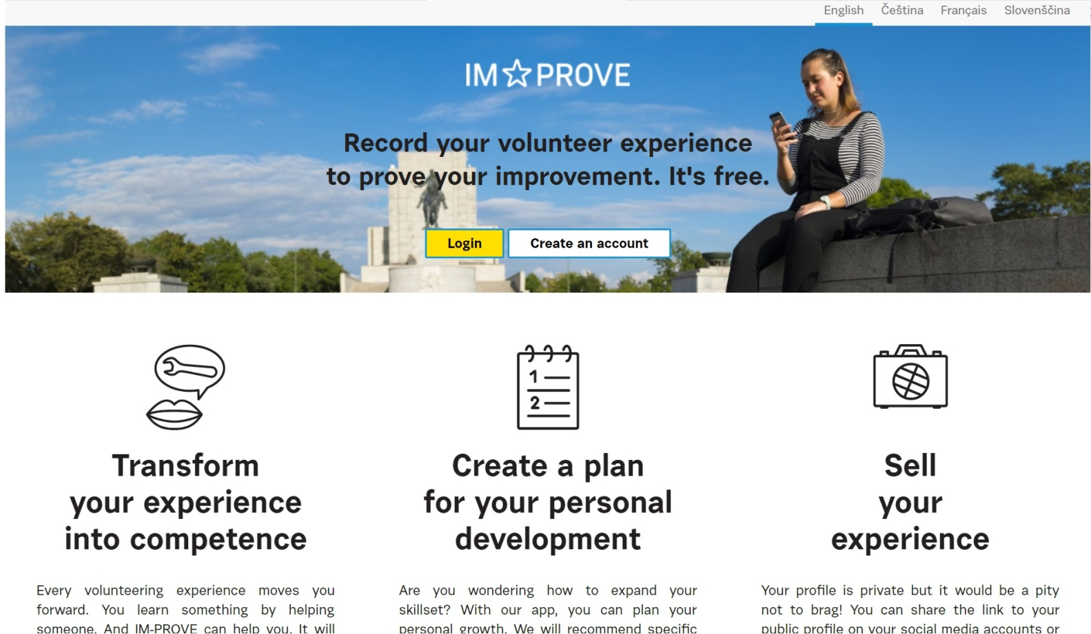
IM-PROVE – How does it work?
improve.inexsda.cz
Notes:
Let‘s have a look on the application‘s functionalities. First you must go to this website to register (only e-mail and password).

Slide 4
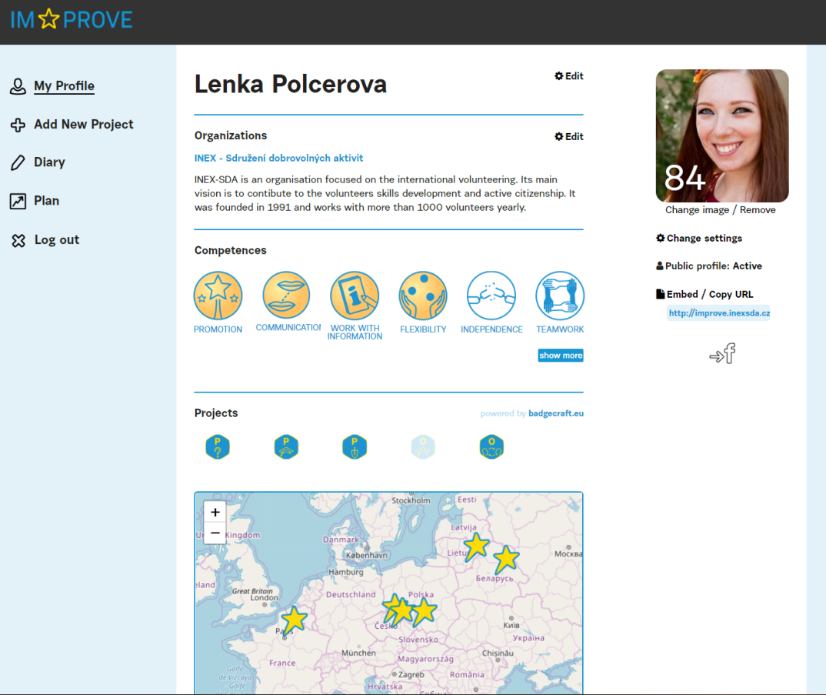
IM-PROVE – How does it work?
Profile of the user displays:
number of points (counted from the experiences the user has put into the application)
info about the organisation
competences (displayed as „medals“)
electronic badges user got for his/her projects
map of one‘s volunteering projects
From this page, you will also get to your public profile (menu below photo).
Notes:
Public profile can be shared on LinkedIn, CV or however the user wants to prove, how useful was the volunteering experience for his/her development. According to the research INEX-SDA, Závod Voluntariat and Solidarités Jeunesses has done, it has a value in interviews expecially if the competences and experiences are relevant for the position that the candidate applies for.

Slide 5
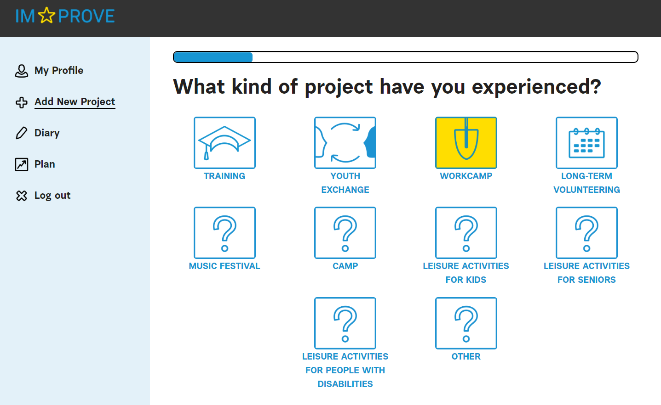
IM-PROVE – How does it work?
Entering of new project goes in several steps:
1. Select type of the project

Slide 6
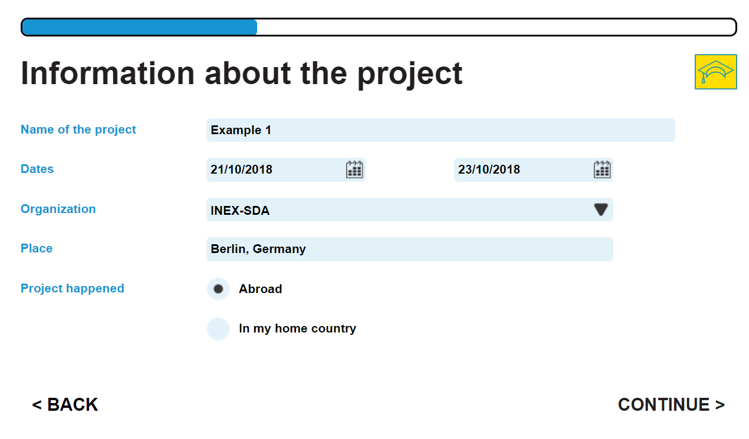
IM-PROVE – How does it work?
2. Enter details of the project

Slide 7
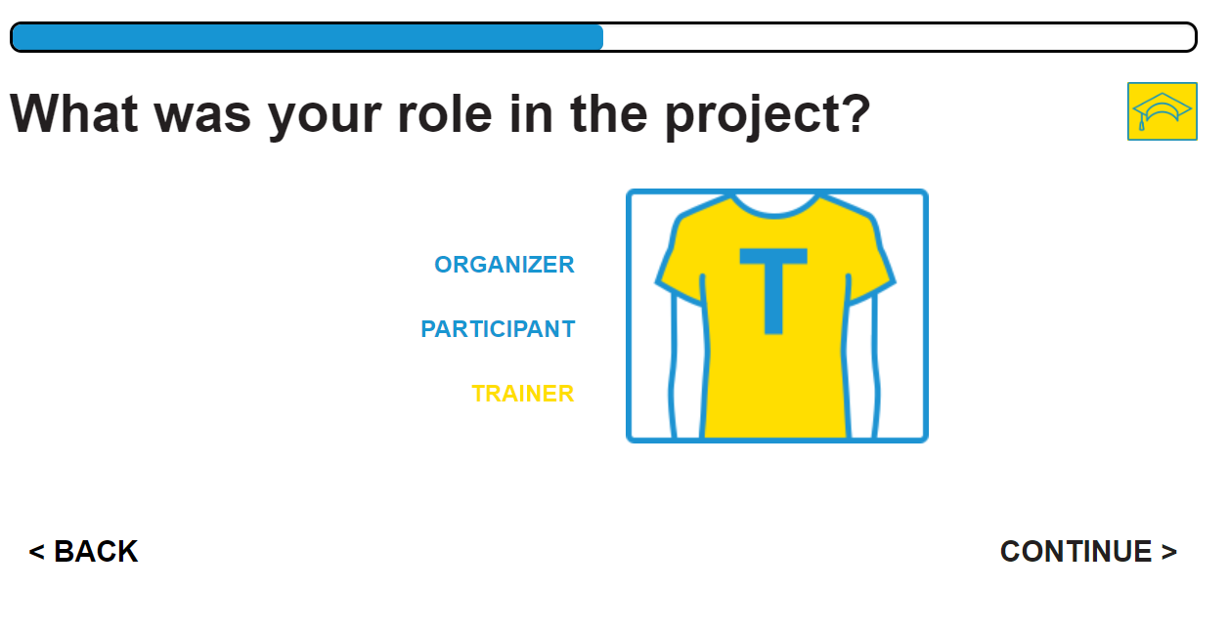
IM-PROVE – How does it work?
3. Select your role in the project

Slide 8
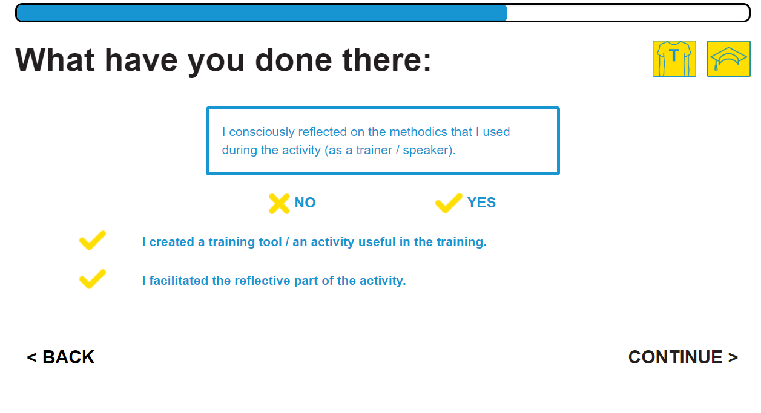
IM-PROVE – How does it work?
4. Choose the experiences you‘ve gone through.

Slide 9
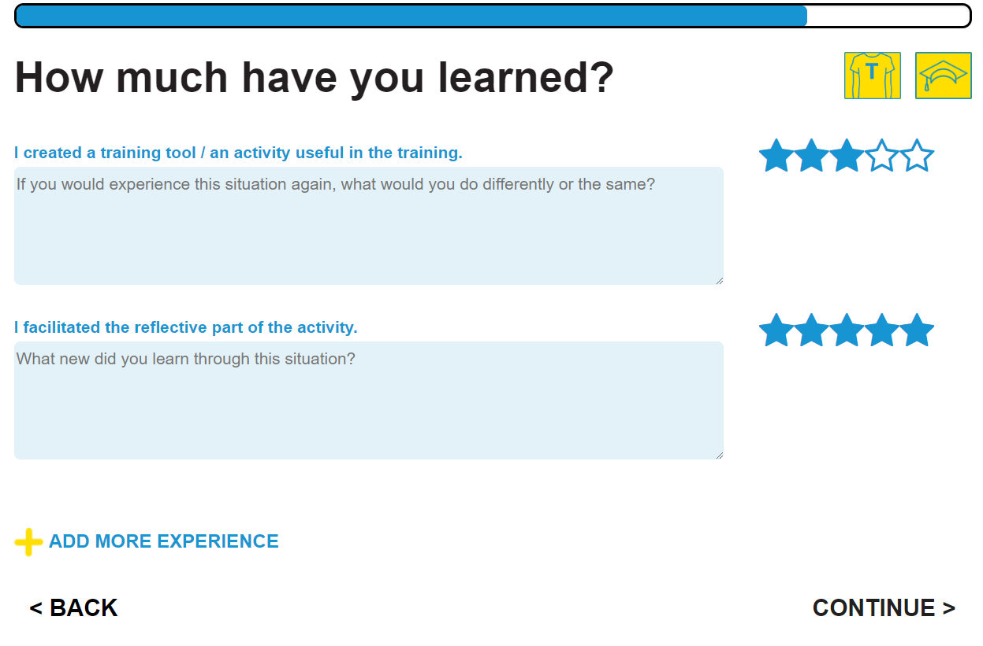
IM-PROVE – How does it work?
5. Evaluate your recorded experiences with stars, you can also write some details about them.
Notes:
There‘s always 6 experiences the user can choose from. He/she can add more epxerience to have more experiences to select. The users are always looking for the pre-defined experiences most close to their own. Currently, it‘s not possible to add new individualised experiences.

Slide 10
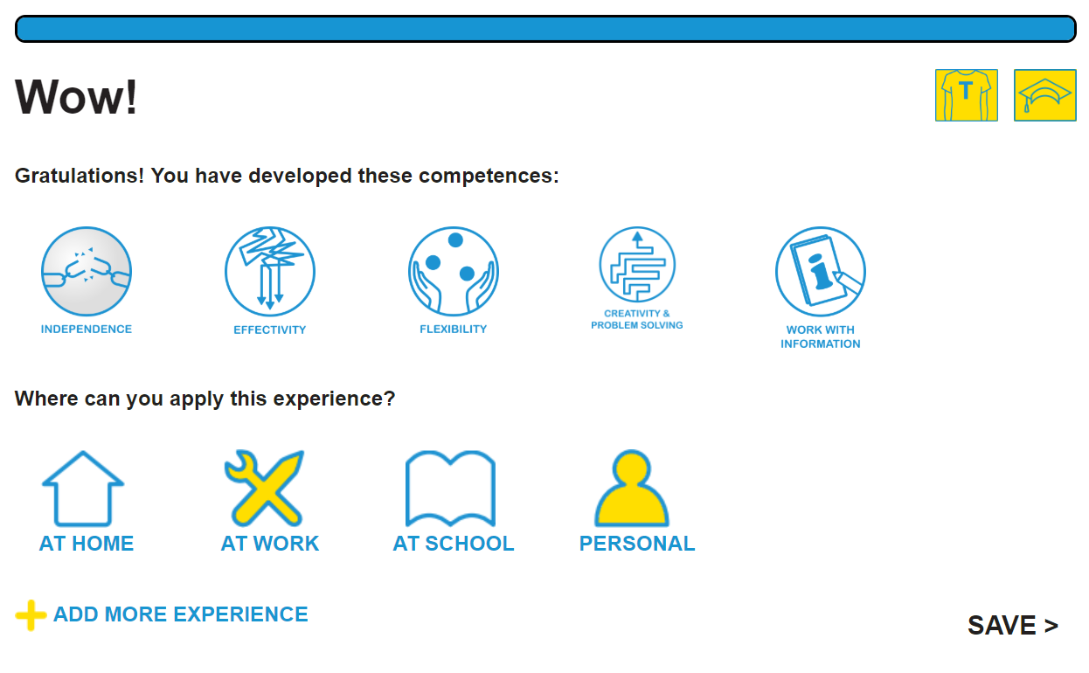
IM-PROVE – How does it work?
6. Save the project and option to add more experience to the project.
Notes:
Where to apply this experience – another reflection of the user towards where he/she can use the experiences in practice.

Slide 11
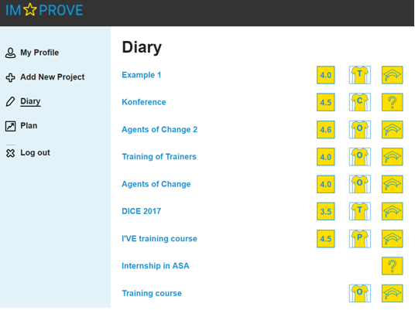
IM-PROVE – How does it work?
In Diary, the user has overview of his/her recorded projects in different roles and about his/her evaluation of the experiences.
Of course, it‘s possible to click and edit the projects.

Slide 12
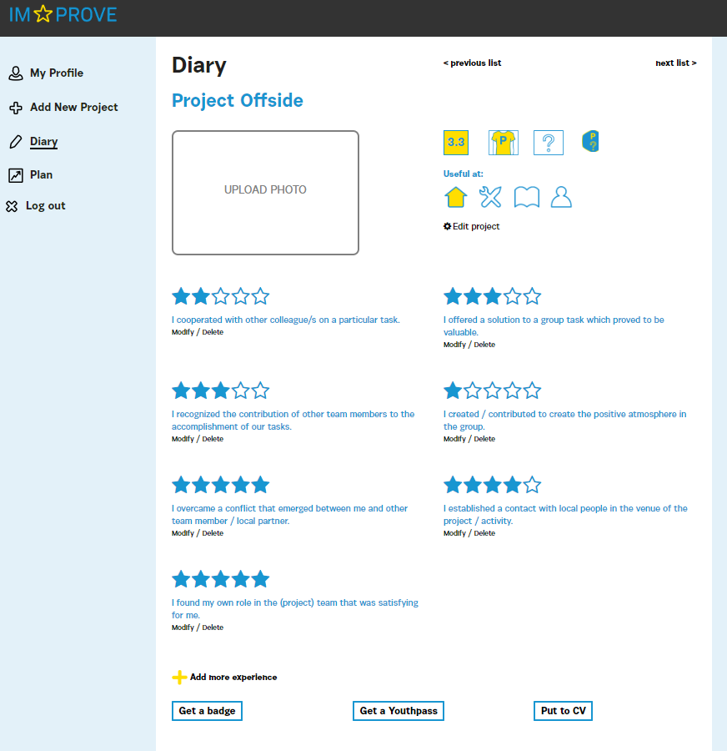
IM-PROVE – How does it
work?
Besides editing the project and adding more experiences, there are more options:
Ask organizers for electronic badge, by which they will confirm the user‘s experiences recorded in the application. You should have at least 7 recorded experiences to get a badge.
Get info, which experiences can be recorded into Youthpass and how to do it (for Erasmus + and European Solidarity Corps projects).
Get info about how to write experiences into CV in Europass format.
Notes:
Badges allow to confirm experiences of the user recorded in the application. It mainly serves for their public profile – if they present the profile e.g. When looking for a job, the badges are a proof of the recorded experience from someone from the organizers. The people reviewing one‘s job application therefore have more credible proof of one‘s competences relevant for the job.
Volunteers often fight with how to record their experiences into Youthpass or CV, which of their experiences belongs to which competence etc. That‘s why the process is simplified thanks to IM-PROVE – on this page it is advised, which of their recorded experience belog to which Youthpass/CV box.

Slide 13
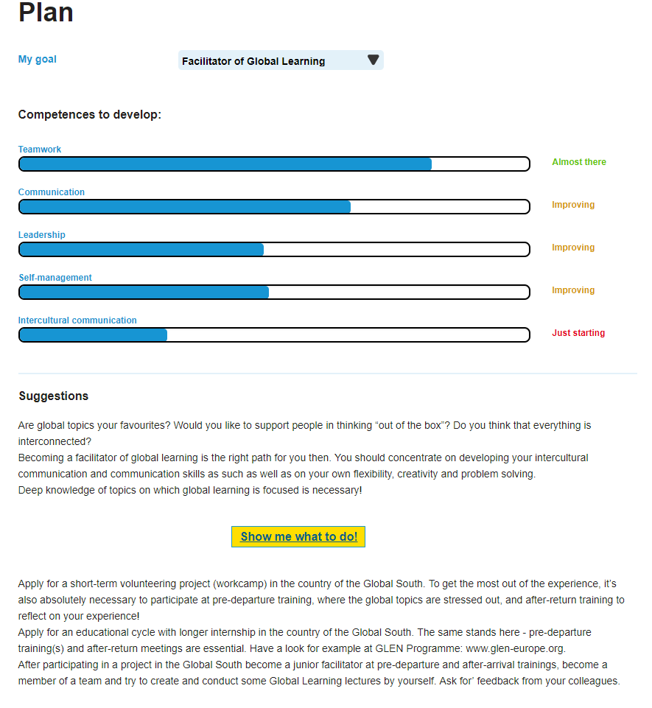
IM-PROVE – How does it
work?
Important functionality is also planning, where the user can select, to which „goal“ or role he/she would like to aim.
The application then advises, on which competences to focus and suggests, what the user could do to reach this goal.

Slide 14
Other information about IM-PROVE
Find it on improve.inexsda.cz – this is a full version of the app, you can open it on computer as well as in browser on your mobile phone
Light version – mobile app – downloadable App Store (iOS) and Play Store (Android).
Languages: Czech, Slovene, English, French

Slide 15
CONTACT:
E: improve@inexsda.cz T: +420 222 362 713

